Slide 1





UNITED COLLEGE OF ENGINEERING AND RESEARCH
<--A MINI PROJECT ON-->
HOUSE PRICE PREDICTOR
UNDER THE GUIDANCE OF:MRS.PALLAVI SHUKLA

Slide 2
”STOP DREAMING
AND START
BUYING”

Slide 3
”WORRIED
ABOUT HEFTY
PRICES”

Slide 4
HOME VALUE
AI
A SOLUTION TO PRICE BASED CONFUSIONS OF A BUYER

Slide 5
PURPOSE OF THIS PROJECT
Develop a predictive model to estimate Bengaluru house prices based on:-
Location
Total square feet
BHK
Bathrooms
Enable accurate price estimation for informed decision-making.
01 - PREDICTIVE MODELING
Provide data-driven insights into the Bengaluru real estate market
Identify key factors influencing house prices
Enable informed decision-making for:
- Potential buyers
- Sellers
- Investors
02 - DATA-DRIVEN INSIGHTS
03 - USER-FRIENDLY INTERFACE
Design a user-friendly Tkinter GUI for effortless data input
Display predicted house prices in an intuitive format
Broaden model accessibility beyond technical experts

Slide 6
SCOPE OF THIS PROJECT
Data collection and preprocessing from a specific dataset (Bengaluru house prices)
Development of a predictive model using regression techniques (Linear, Lasso, Ridge)
Creation of a GUI application using Tkinter for user input and prediction output
Model evaluation and validation using metrics such as R2 score
Limited to Bengaluru real estate market; may not generalize to other locations

Slide 7
PROPOSED SYSTEM
Predictive Modeling: Develop a machine learning-based predictive model to estimate house prices in Bengaluru based on historical data and key factors such as location, total square feet, BHK, and bathrooms.
User-Friendly Interface: Design and implement a intuitive graphical user interface (GUI) using Tkinter, allowing users to easily input data and receive predicted house prices.
Data-Driven Insights: Provide actionable insights into the Bengaluru real estate market, identifying key factors influencing house prices and enabling informed decision-making for buyers, sellers, and investors.
Real-Time Predictions: Enable real-time predictions for users, allowing them to input custom data and receive instant estimated house prices.
Scalability and Flexibility: Develop a scalable and flexible system, adaptable to changing market trends and capable of incorporating additional features or data sources as needed.

Slide 8
PROPOSED SYSTEM(CONT...)
Testing and Validation:-
1. Testing predictive model accuracy
2. Validating GUI functionality
3. Conducting user acceptance testing (UAT)
4. Iterating on feedback and improvements
Deployment and Maintenance:-
1. Deploying the system (locally or on cloud)
2. Monitoring system performance
3. Updating models with new data
4. Maintaining and updating GUI as needed
Analysis and Insights:-
1. Analyzing market trends and patterns
2. Identifying key factors influencing house prices
3. Providing data-driven insights for stakeholders
4. Refining the model based on new insights

Slide 9
MODEL FUNTIONALITIES
Data Input
Accepts user input for location, total square feet, BHK, and bathrooms
Handles missing values and outliers
Predictive Modeling
Estimates house prices based on historical data and key factors
Utilizes machine learning algorithms (Linear Regression, Lasso, Ridge)
Provides accurate and reliable price predictions
Data Analysis
Identifies key factors influencing house prices
Analyzes market trends and patterns
Offers data-driven insights for stakeholders
User Interface
Intuitive graphical user interface (GUI) using Tkinter
Easy data input and prediction output
Real-time predictions and updates

Slide 10
MODEL FUNTIONALITIES(CONT...)
Performance Metrics
Evaluates model accuracy using R2 score and mean squared error
Monitors and optimizes model performance
Scalability and Flexibility
Adaptable to changing market trends and data
Incorporates additional features or data sources as needed

Slide 11
TECHNOLOGIES USED
Programming Language:
Python: Used for developing the predictive model, data analysis, and GUI.
Machine Learning Library:
scikit-learn: Utilized for building and training the predictive model, specifically for regression tasks.
Data Analysis and Processing:
Pandas: Used for data manipulation, cleaning, and preprocessing.
NumPy: Employed for numerical computations and data transformations.
Graphical User Interface (GUI):
Tkinter: Python's built-in GUI library, used for creating the user-friendly interface.
Data Visualization:
Matplotlib: Used for creating plots and visualizations to understand data distributions and model performance.

Slide 12
USER INTERFACE
1. Intuitive Design: The GUI is designed with a user-friendly interface using Tkinter, allowing users to easily input data and receive predicted house prices.
2. Key Features: The interface includes essential features such as:
Data input fields (location, total square feet, BHK, bathrooms)
Predict button to generate estimated house prices
Clear display of predicted prices
Optional: visualizations, error handling, and help/documentation

Slide 13
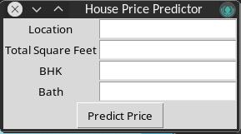
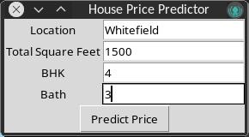
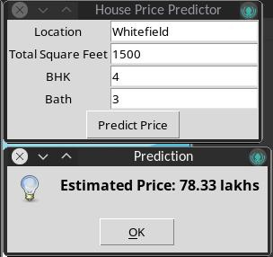
SNAPSHOTS

Slide 14
THANK YOU
www.reallygreatsite.com

